Slide 1
Myntra Analysis

Slide 2
About the Company
Myntra is one of India’s leading e-commerce platforms, primarily focusing on fashion and lifestyle products. It was founded by Mukesh Bansal, Vineet Saxena, Ashutosh Lawania in 2007 and originally started as a personalized gift items platform, but over time, it transitioned into a major online fashion marketplace.

Slide 3
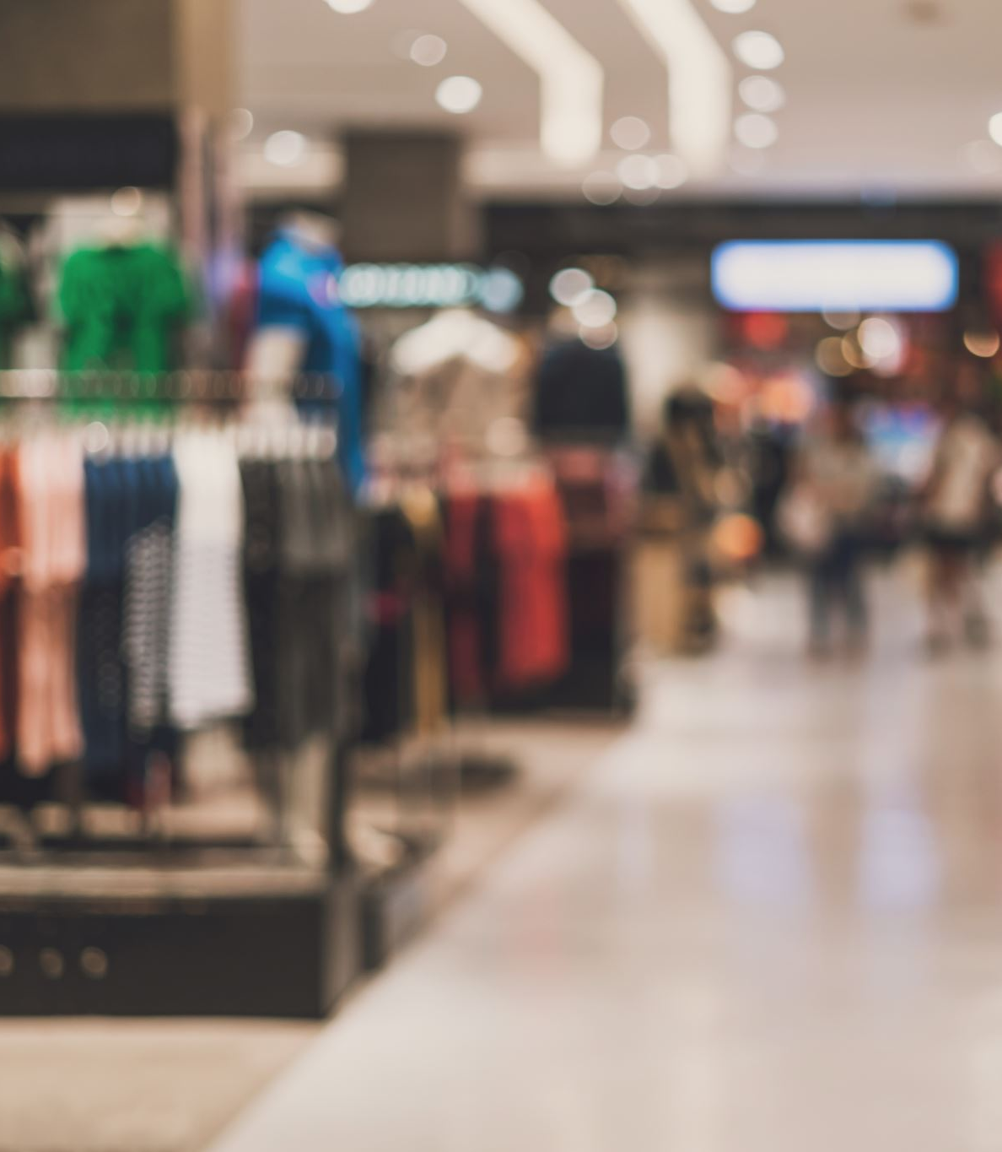
Business Model
Myntra operates as a major online fashion retailer in India, primarily focused on selling clothing, accessories, footwear, and lifestyle products. Its business model revolves around several key elements:
Marketplace Model: Myntra functions as an online marketplace, partnering with numerous brands and sellers to offer a wide variety of products. It does not own most of the inventory but connects buyers and sellers through its platform.
Private Labels: Myntra also offers its own private label brands (like Roadster, HRX, DressBerry, etc.), giving them higher margins and more control over pricing, inventory, and quality.
Tech-Driven Personalization: The platform uses AI and machine learning to offer personalized recommendations, enhance customer experience, and streamline product searches based on user preferences.
Omnichannel Presence: Myntra has integrated online and offline retail through partnerships with brick-and-mortar stores, allowing users to order online and pick up in-store or return in-store.
Sales Events: Periodic mega-sale events like “End of Reason Sale” attract large numbers of customers with significant discounts and promotions, increasing sales and customer engagement.
Logistics and Delivery: Myntra relies on its in-house logistics arm, Myntra Logistics, ensuring efficient delivery and returns, while also collaborating with third-party logistics partners for broader reach.
Revenue Streams: Myntra generates revenue from commissions on sales, brand advertisements on its platform, and private label sales.

Slide 4

Brand Perception through Social Media and Reviews
Positive Brand Perception
Wide Range of Products: Myntra is praised for offering a vast collection of clothing, accessories, and footwear for men, women, and kids, covering both affordable and premium brands.
User Experience: Its app and website are appreciated for being user-friendly, with features like easy navigation, size recommendations, and quick access to sales and offers.
Discounts and Offers: Myntra is known for providing frequent discounts, sales events (like the End of Reason Sale), and app-exclusive deals, making it popular among bargain-hunters.
Efficient Customer Service: Quick responses to queries and smooth issue resolution, such as refunds and exchanges, contribute to positive brand sentiment.
Fast Delivery and Returns: The logistics are generally perceived well, especially in metropolitan areas, with prompt deliveries and easy returns, which builds trust with the customers.
Negative Brand Perception
Quality Concerns: Some customers have raised concerns about the quality of certain products not meeting their expectations, especially when compared to the images shown on the platform.
Price Transparency: While many appreciate discounts, there are instances where customers feel the pre-discount prices are inflated to make discounts seem more appealing, leading to some distrust.
Delivery Delays: In smaller cities or during peak sale periods, delayed deliveries can frustrate customers, contributing to negative reviews on social media.
Customer Support Issues: Although the service is often praised, there are instances where customers have experienced delays in getting refunds or exchanges processed or found the customer service unresponsive.

Slide 5
Brand Perception through Social Media and Reviews
Social Media Sentiment
Engagement and Promotions: Myntra actively engages its audience through social media platforms like Instagram, Twitter, and Facebook. Promotions, influencer marketing, and collaborations with celebrities help create a trendy, youthful brand image.
Influencer Marketing: Partnerships with fashion bloggers and influencers create a positive brand association among younger customers, promoting Myntra as a go-to destination for trendy, fashionable items.
Social Media Feedback: On platforms like Twitter, customers often express their complaints publicly, especially regarding late deliveries, product issues, or app glitches. However, Myntra’s social media team is generally quick to respond, which helps to resolve issues and mitigate negative feedback.
Reviews on E-commerce Platforms
Product Reviews: The review section on Myntra often shows varied feedback, with customers giving detailed insights on the fit, material quality, and value for money. Positive reviews highlight trendy, affordable fashion, while negative reviews point out inconsistencies in sizing or color differences.
Ratings: Myntra has a generally favorable rating, with many customers giving high marks for trendy products and the shopping experience. However, isolated instances of product defects or miscommunication in customer service can skew perceptions negatively.

Slide 6

Customer Sentiment Analysis & Market Trends
Customer Sentiment Analysis:
Positive Sentiment: Myntra is widely appreciated for its vast selection of products, frequent discounts, and user-friendly app interface.
Negative Sentiment: A common theme in negative feedback revolves around delayed deliveries, product quality mismatches, and poor return experiences.
Neutral Sentiment: A significant portion of customer feedback pertains to routine transactional comments, such as order confirmations, which do not offer actionable insights.
Market Trends:
Emerging Trends: There is a rising demand for sustainable fashion, activewear, and influencer-driven styles. Consumers are increasingly prioritizing eco-friendly and ethically sourced clothing.
Competitor Analysis: Competitors like AJIO and Amazon Fashion are gaining ground by offering faster delivery options and exclusive collections. Additionally, international brands like Zara and H&M are leveraging collaborations with celebrities to enhance brand visibility.

Slide 7
Comparative analysis of Myntra and its competitors
Market Position and Reach:
Myntra is a leader in the online fashion space in India, with a significant market share. It benefits from being a part of Flipkart, which gives it access to a larger customer base and logistical support.
Amazon India, another significant competitor, offers fashion but primarily focuses on a wide variety of products. Its fashion section is growing but does not have the fashion-centric identity that Myntra has.
Ajio, owned by Reliance, is one of Myntra's direct competitors. It is gaining traction due to Reliance’s deep retail presence and aggressive pricing strategies.
Customer Base:
Myntra has a loyal customer base, with strong penetration in the urban youth segment. Its End of Reason Sale (EORS) and frequent discount events help attract price-sensitive customers.
Amazon and Flipkart attract a more general audience that includes fashion but extends to other categories, diluting their focus on apparel.
Ajio is working to expand its reach by targeting younger audiences with fashion-forward collections and exclusive collaborations.
Product Assortment & Brands:
Myntra has an extensive selection of brands, including exclusive tie-ups with international brands like H&M and Marks & Spencer, and a strong portfolio of in-house brands (like Roadster, HRX, and DressBerry).
Ajio also offers a wide range of brands, including Reliance's private labels, but has been pushing unique fashion curation.
Amazon Fashion offers many brands but is not as curated or trendy as Myntra. Its strength is in providing everything, but it lacks Myntra’s specialization in fashion.

Slide 8
Comparative analysis of Myntra and its competitors
Delivery and Returns
Myntra: Offers competitive delivery times and a 30-day return policy. The logistics are optimized for fashion items, with quick refunds and hassle-free returns.
Amazon Fashion: Known for its robust and fast delivery, especially for Prime members. Return policies are consumer-friendly, though Amazon’s vast product range sometimes complicates specific fashion returns.
Flipkart: Has similar delivery options to Myntra, though fashion may not be as streamlined. The return process is efficient, particularly for Flipkart Plus members.
Customer Loyalty Programs
Myntra: Offers Myntra Insider, a loyalty program that provides early access to sales, free shipping, and additional discounts based on spending levels.
Amazon Fashion: Benefits from Amazon Prime, which provides fast delivery, exclusive deals, and access to other services like Prime Video and Music.
Flipkart: Flipkart Plus offers similar benefits to Myntra Insider, with early access to sales and free shipping.
Ajio: Offers frequent discounts and loyalty benefits, although it lacks a dedicated loyalty program like Myntra Insider.
Summary of Competitive Position:
Myntra maintains a strong foothold in fashion, with a balanced mix of high-end and affordable products, excellent app experience, and a comprehensive loyalty program.
key strength lies in its specialized focus on fashion and lifestyle with a large variety of brands and pricing options, making it a versatile platform for a wide range of consumers.

Slide 9
Strategic recommendations for improving the market position
Strengthen Private Labels
Enhance Product Portfolio: Myntra should expand its private label offerings by introducing new categories or enhancing current ones, targeting different price points and niche fashion trends. Private labels often provide higher margins and build brand loyalty.
Sustainable Fashion: Invest in eco-friendly private label products as sustainability is a growing trend. Creating collections using organic materials or ethical production practices can cater to environmentally conscious consumers.
Personalization and AI-driven Recommendations
AI-powered Personalization: Use advanced machine learning algorithms to deliver hyper-personalized shopping experiences. This can include personalized product recommendations, curated outfit suggestions, and dynamic styling tips.
Predictive Analytics for Trends: Implement predictive analytics to anticipate fashion trends based on customer data, social media signals, and global fashion patterns, allowing Myntra to stock trend-forward items early.
Leverage Social Commerce and Influencer Partnerships
Social Commerce Integration: Collaborate with social media platforms to integrate shopping experiences seamlessly. Features like live shopping events, shoppable posts, and Instagram Stories’ "Swipe Up" shopping feature can drive real-time engagement.
Influencer Partnerships:
Collaborate with micro-influencers and fashion bloggers to create authentic, localized campaigns. These collaborations can help drive brand awareness and create a sense of community around Myntra's products.
Strengthen Customer Loyalty Programs
Enhanced Loyalty Program: Upgrade the loyalty program (Myntra Insider) with exclusive perks like early access to sales, personalized styling services, and more VIP experiences for loyal customers.
Subscription Services:
Launch a subscription model where customers get access to exclusive benefits, such as free shipping, monthly style tips, or discounted outfits, building recurring revenue.

